Slide 1
Swiggy Analysis Report
GUVI –BADM-Project1
Ramya Raghavan
MB28

Slide 2
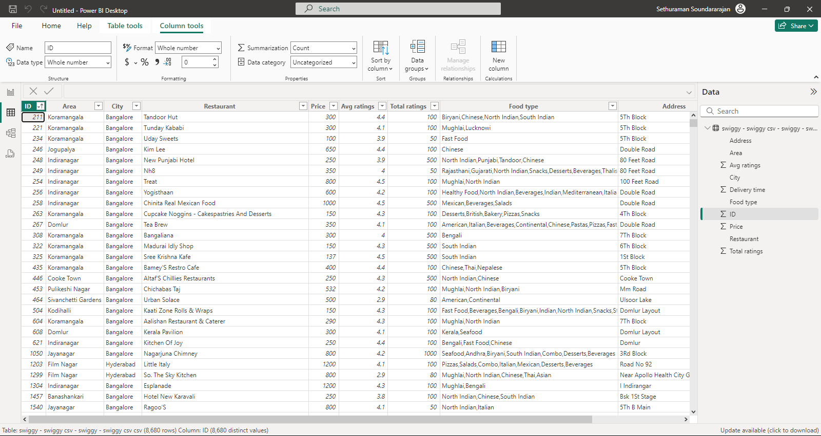
CSV file -> Power BI
The swiggy CSV file is uploaded in Power BI , and the file is sorted based on id with 8680 records.

Slide 3
Identification and understanding the data
Column Name | Data Type | Description
ID | Whole number | Restaurant id
Area | Text | Area/neighborhood of the restaurant
City | Text | Restaurant’s city
Restaurant | Text | Restaurant name
Price | Whole number | Average cost of the dish
Avg ratings | Decimal number | Average rating
Total ratings | Whole number | Total Rating
Food type | Text | Type of the food/cuisine
Address | Text | Restaurant address(the street/Road name)
Delivery time | Whole number | Delivery time(restaurant to customer)

Slide 4
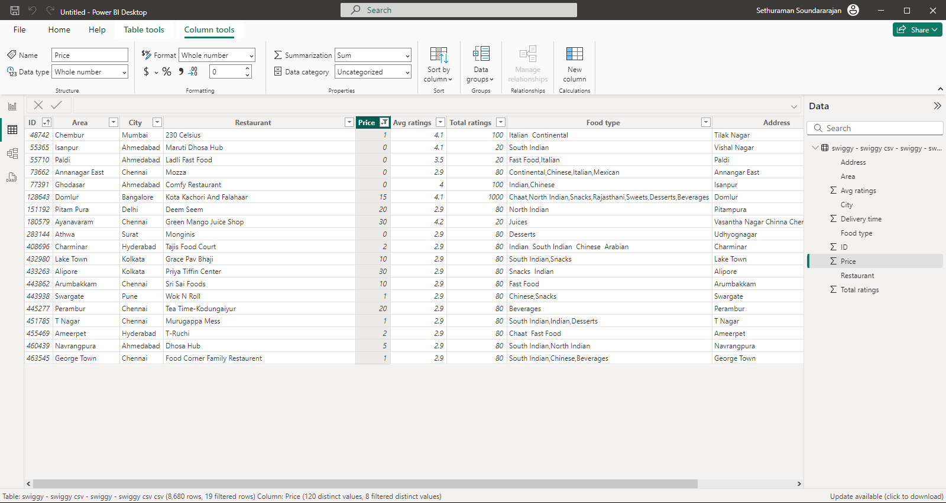
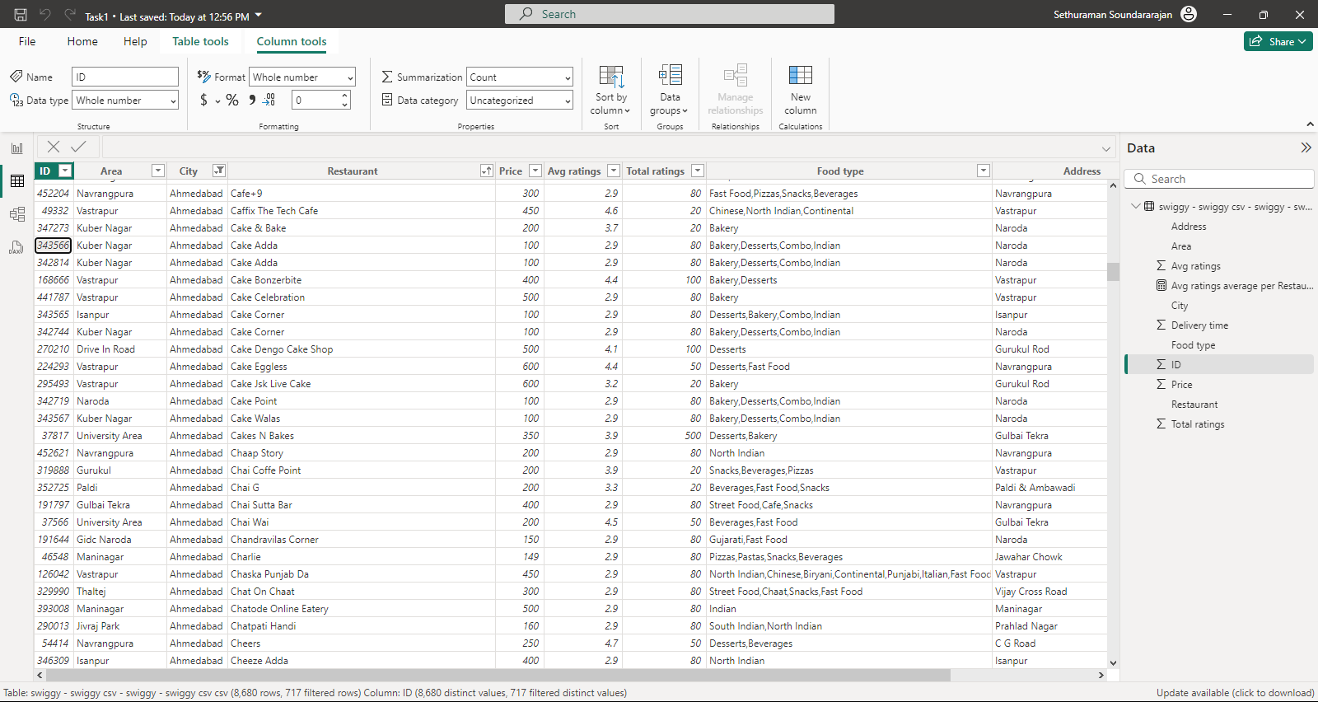
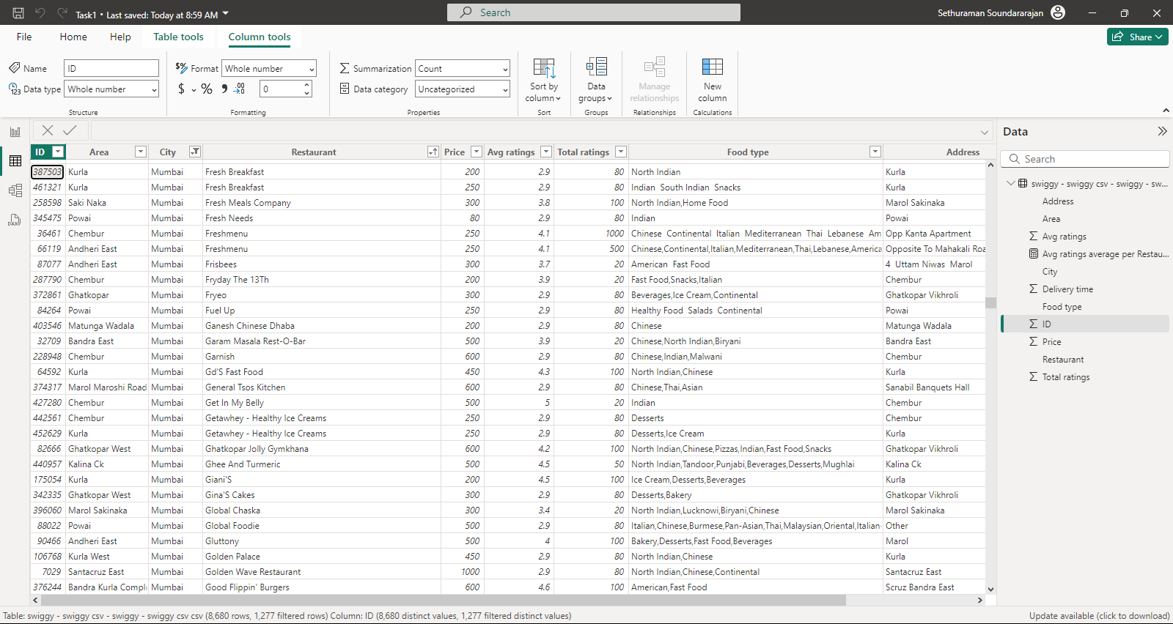
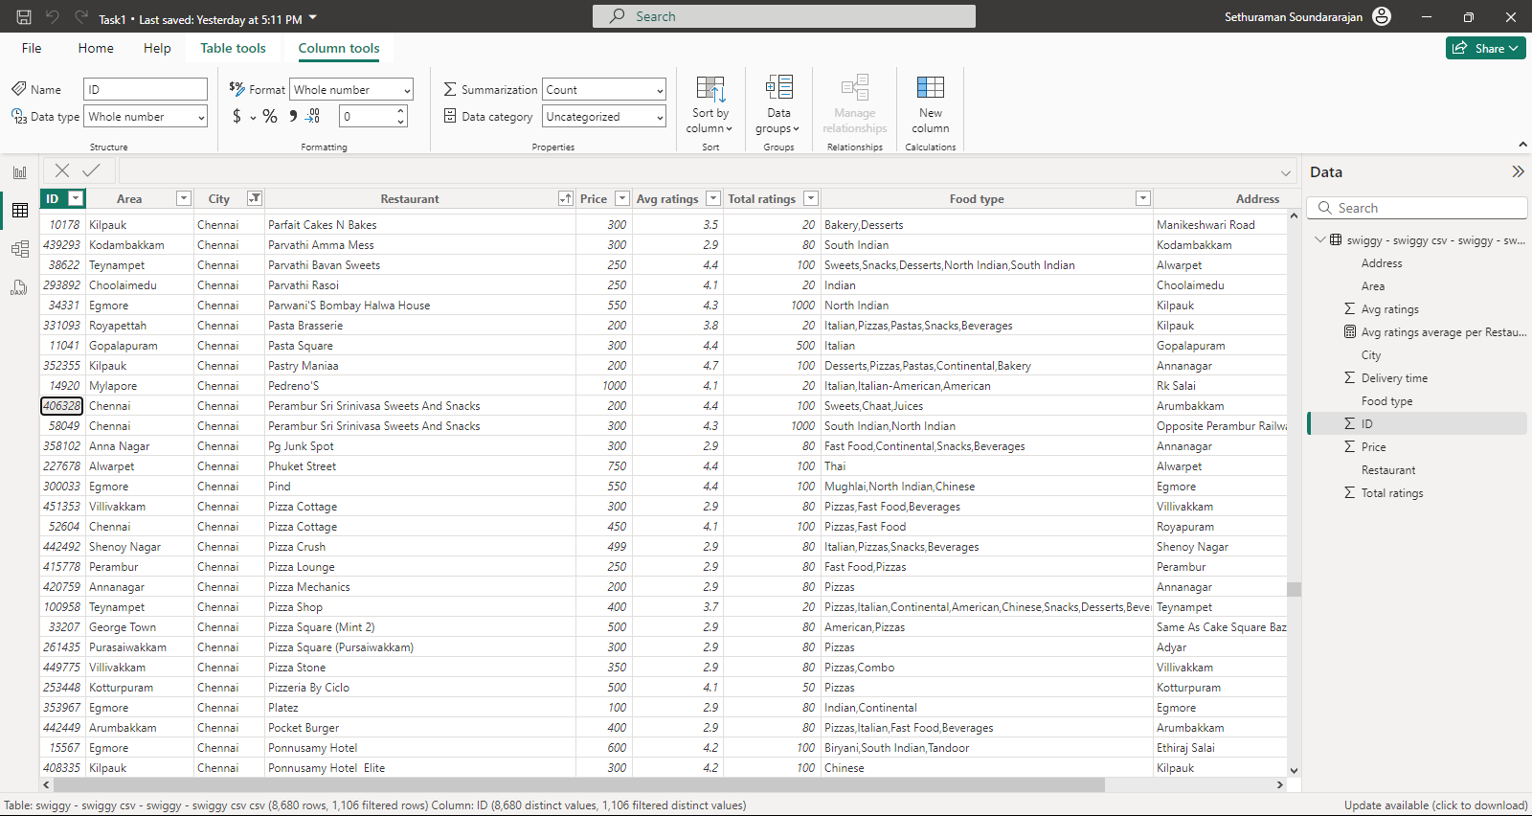
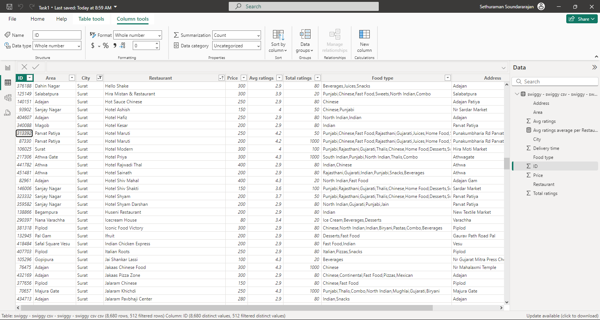
Challenges in the data
Duplicate rows 347273,343566 , restaurant name : Cake adda
Has unique id , other values are same
Since the id are unique they are considered as different data ,confirmed by mentors too
There are price values for 19 filtered rows whose price ranges from (0->30)
Confirmed from mentor team that the impact is less and negotiable
The id 387503 and 461321 have the same fields except for price and delivery time , are they considered different records
Mentor team confirmed as different records due to unique id
The id 406328 and 58049 have the area and city name as same values “Chennai”
Though the address and other values are different
Can we edit the area field according to the address
The id 52604 has the area and city as Chennai , can we change the area according to the address.
Mentor team confirmed it as unique records due to unique id
The id 313392 and 87330, almost have same values except for price and total ratings
Can these be considered as 2 different rows only?
Mentor team confirmed as unique rows

Slide 5
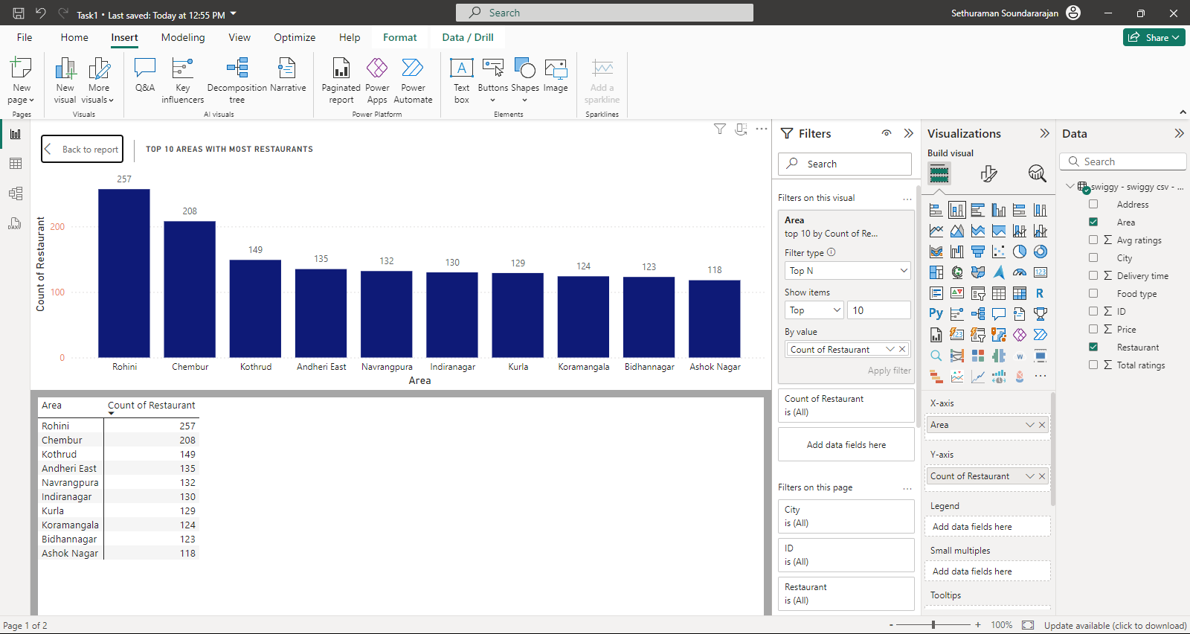
Top 10 Areas with Most Restaurants
Area | Count of Restaurant
Rohini | 257
Chembur | 208
Kothrud | 149
Andheri East | 135
Navrangpura | 132
Indiranagar | 130
Kurla | 129
Koramangala | 124
Bidhannagar | 123
Ashok Nagar | 118
After plotting the values of Area and count of restaurant in the stacked column chart, the filter TOP N is used to filter the top 10 areas.
Area Name | City
Ashok nagar | Bangalore,Pune,Delhi, Chennai and Hyderabad
Bidhannagar | Kolkata
Koramangala | Bangalore
Kurla | Mumbai
Indiranagar | Bangalore
Navrangpura | Ahmedabad
Andheri East | Mumbai
Kothrud | Pune
Chembur | Mumbai
Rohini | Delhi

Slide 6
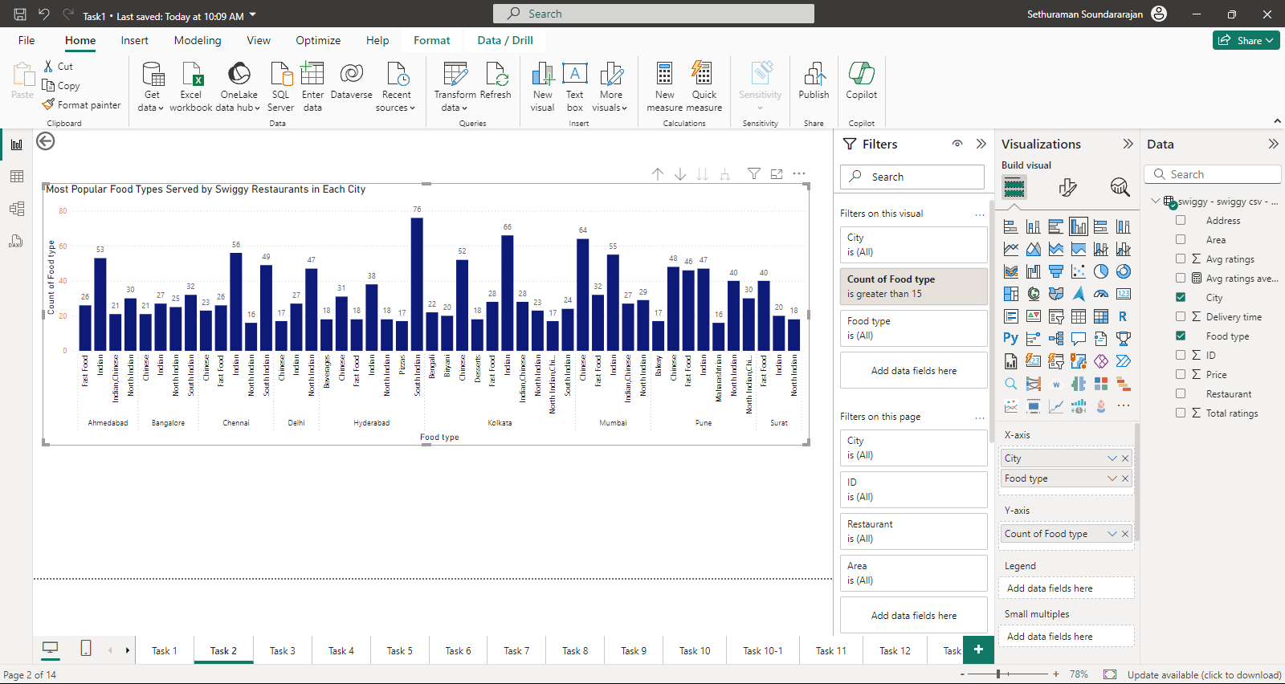
Most Popular Food Types Served by Swiggy Restaurants in each City
City | Count of Food type | Food type
Ahmedabad | 26 | Fast Food
Ahmedabad | 53 | Indian
Ahmedabad | 21 | Indian,Chinese
Ahmedabad | 30 | North Indian
Bangalore | 21 | Chinese
Bangalore | 27 | Indian
Bangalore | 25 | North Indian
Bangalore | 32 | South Indian
Chennai | 23 | Chinese
Chennai | 26 | Fast Food
Chennai | 56 | Indian
Chennai | 16 | North Indian
Chennai | 49 | South Indian
Delhi | 17 | Chinese
Delhi | 27 | Indian
Delhi | 47 | North Indian
Hyderabad | 18 | Beverages
Hyderabad | 31 | Chinese
Hyderabad | 18 | Fast Food
Hyderabad | 38 | Indian
Hyderabad | 18 | North Indian
Hyderabad | 17 | Pizzas
Hyderabad | 76 | South Indian
Kolkata | 22 | Bengali
Kolkata | 20 | Biryani
Kolkata | 52 | Chinese
Kolkata | 18 | Desserts
Kolkata | 28 | Fast Food
Kolkata | 66 | Indian
Kolkata | 28 | Indian,Chinese
Kolkata | 23 | North Indian
Kolkata | 17 | North Indian,Chinese
Kolkata | 24 | South Indian
Mumbai | 64 | Chinese
Mumbai | 32 | Fast Food
Mumbai | 55 | Indian
Mumbai | 27 | Indian,Chinese
Mumbai | 29 | North Indian
Pune | 17 | Bakery
Pune | 48 | Chinese
Pune | 46 | Fast Food
Pune | 47 | Indian
Pune | 16 | Maharashtrian
Pune | 40 | North Indian
Pune | 30 | North Indian,Chinese
Surat | 40 | Fast Food
Surat | 20 | Indian
Surat | 18 | North Indian
Clustered column chart is used to determine the popular food type. The city and food type are plotted in x axis and count of food type are plotted in y axis. Since there are many types of cuisines the filter used here is count of food type greater than 15.Except Kolkata and Mumbai where Chinese food ranks the first place, cities like Ahmadabad, Chennai , Hyderabad and Pune where Indian food tops.North Indian food tops in Delhi and Pune.South Indian food tops in Bangalore

Slide 7
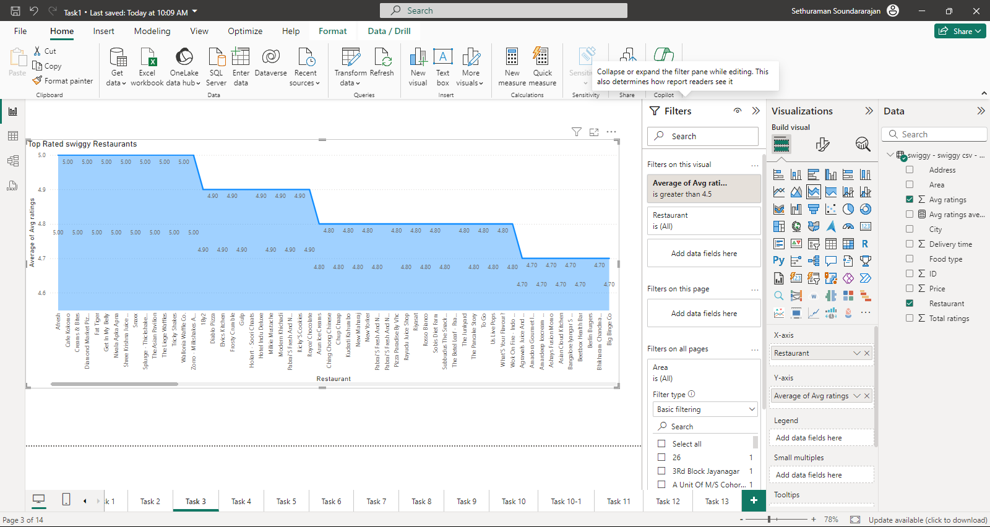
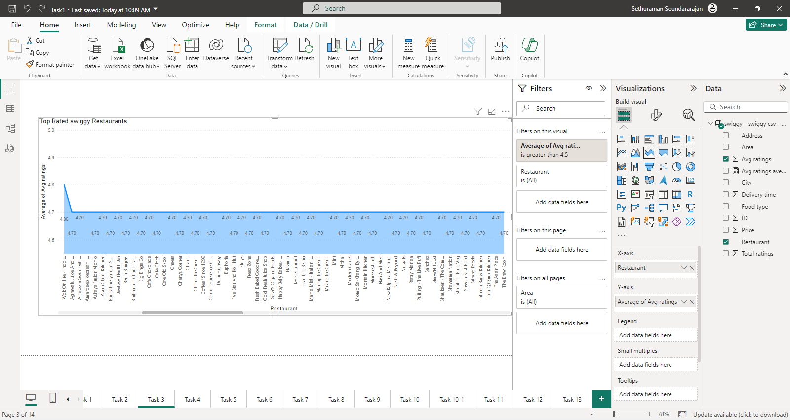
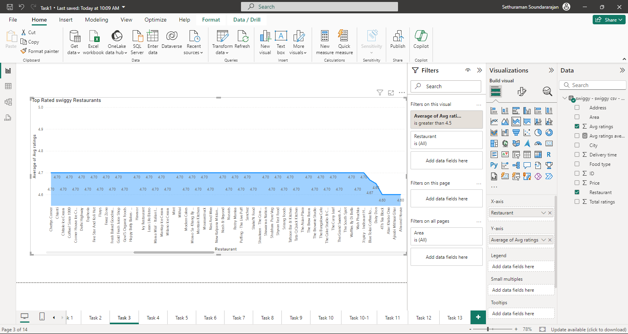
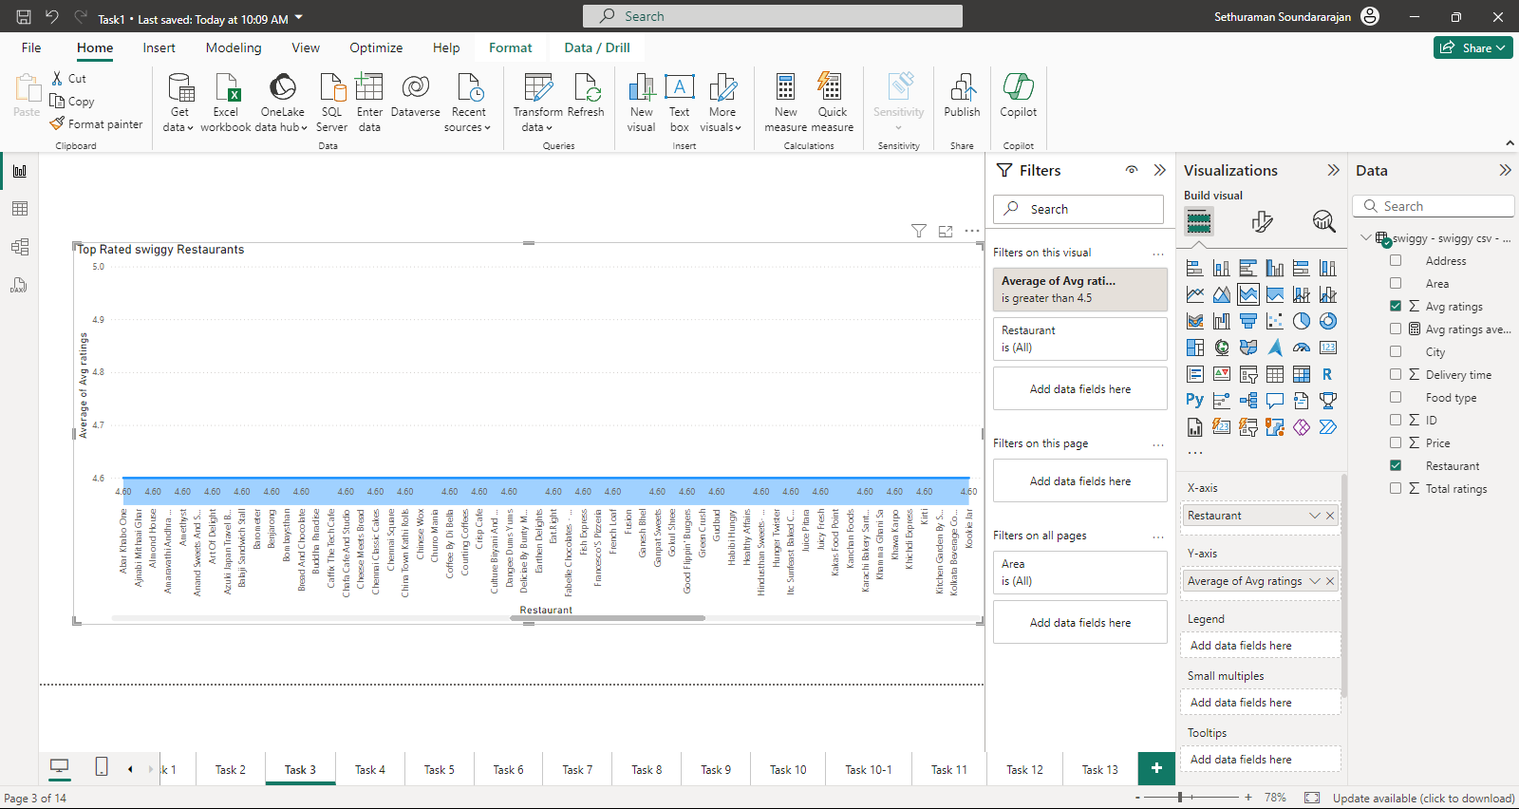
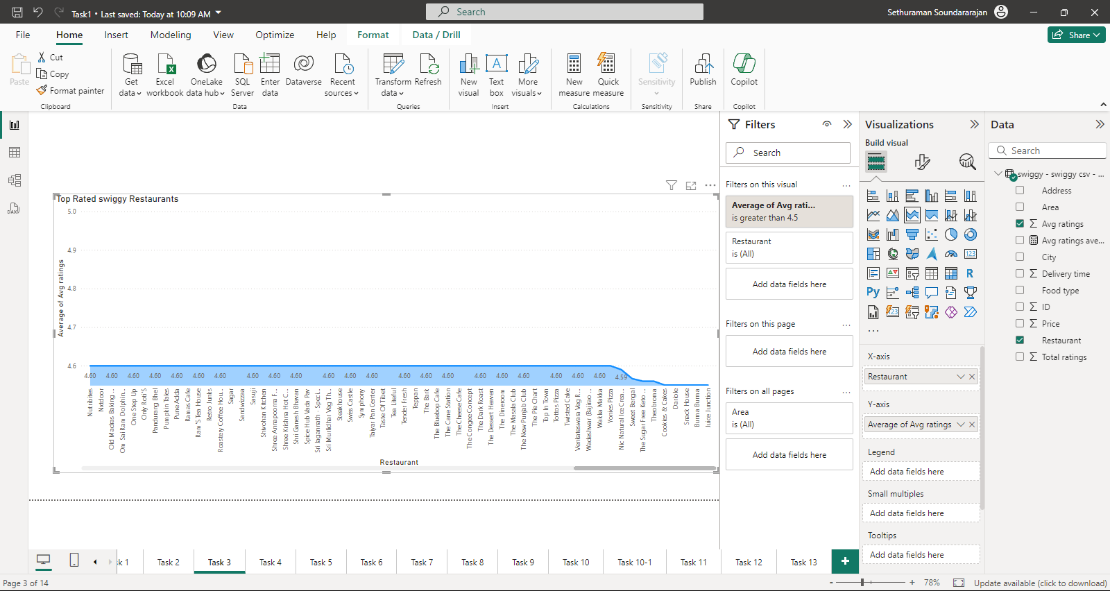
Top Rated Swiggy Restaurants
Average Ratings | Count of Ratings
5 | 15
4.9 | 12
4.8 | 21
4.7 | 66
4.6 | 133
4.5 | 9
Stacked area chart was used to identify the top rated swiggy restaurant whose ratings are greater than or equal to 4.5 , the data is exported and analysed.The count of the ratings are displayed in the table.

Slide 8
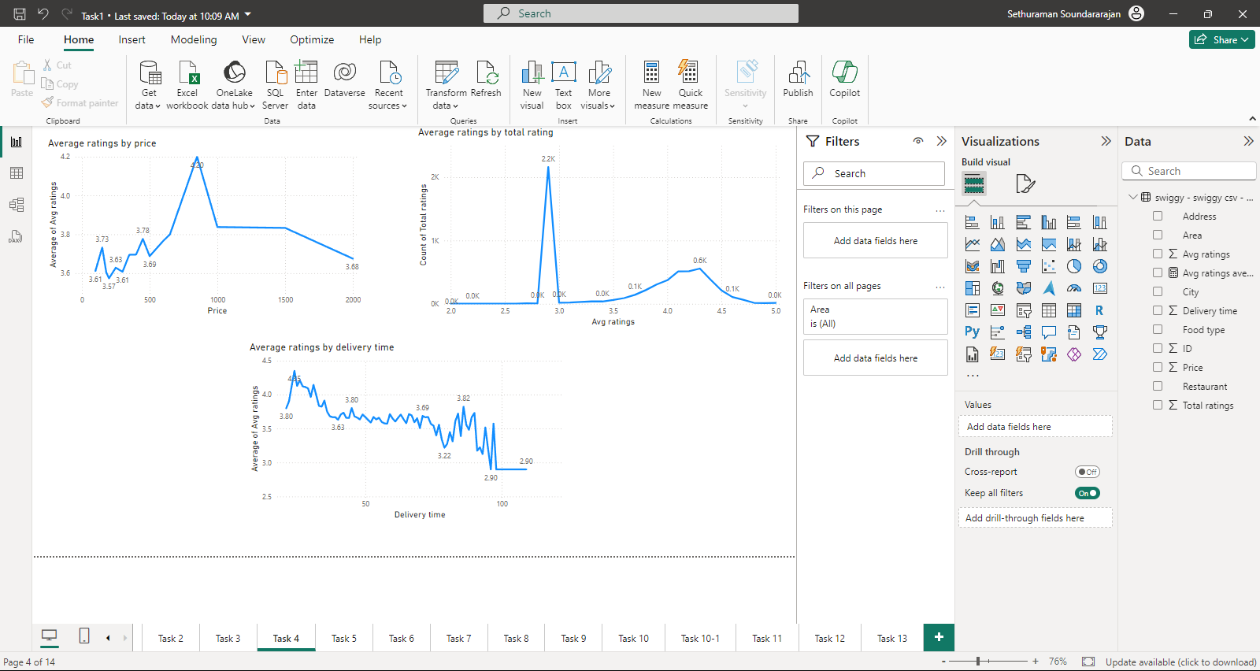
Correlation of Factors Affecting Average Rating
When the delivery time is between 24-29 minutes the rating is high which is about 4% out of 5%. More the delivery time , less the rating.
Price | Average ratings
850 | 4.2
1000 | 3.8
1500 | 3.8
650 | 3.8
450 | 3.8
600 | 3.8
150 | 3.7
400 | 3.7
350 | 3.7
500 | 3.7
2000 | 3.7
250 | 3.6
100 | 3.6
300 | 3.6
180 | 3.6
200 | 3.6
Avg ratings | Count of Total ratings
2.9 | 2163
4.3 | 558
4.2 | 517
4.1 | 512
4.4 | 381
4 | 374
3.9 | 305
3.8 | 217
4.5 | 212
3.7 | 142
4.6 | 108

Slide 9
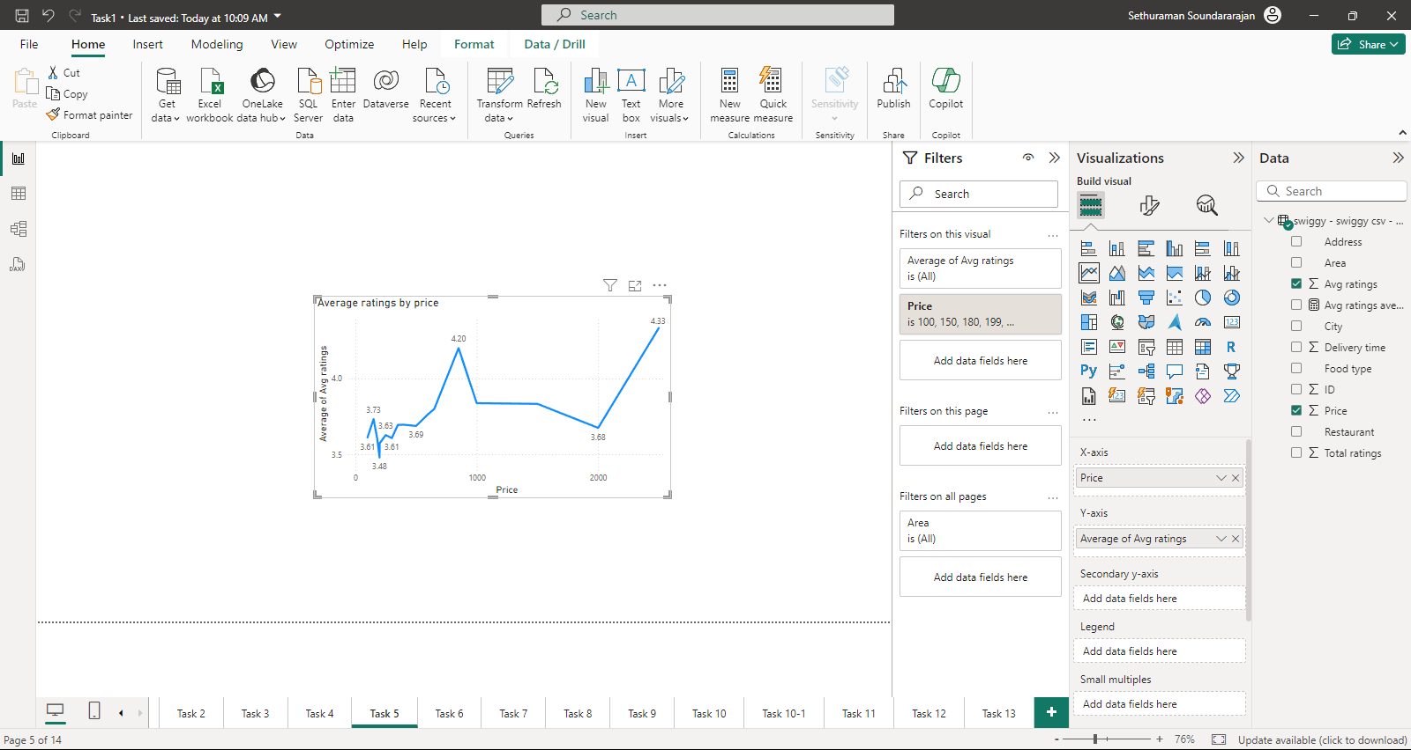
Correlation Between Restaurant Price and Average Rating
Price | Average Ratings
850 | 4.20
1000 | 3.84
1500 | 3.83
650 | 3.80
600 | 3.77
150 | 3.73
400 | 3.70
350 | 3.70
500 | 3.69
2000 | 3.68
250 | 3.63
100 | 3.61
300 | 3.61
180 | 3.60
200 | 3.57
199 | 3.48
It is prominently evident that the price range from 150 to 1500 the Average ratings are high and peaks at 850

Slide 10
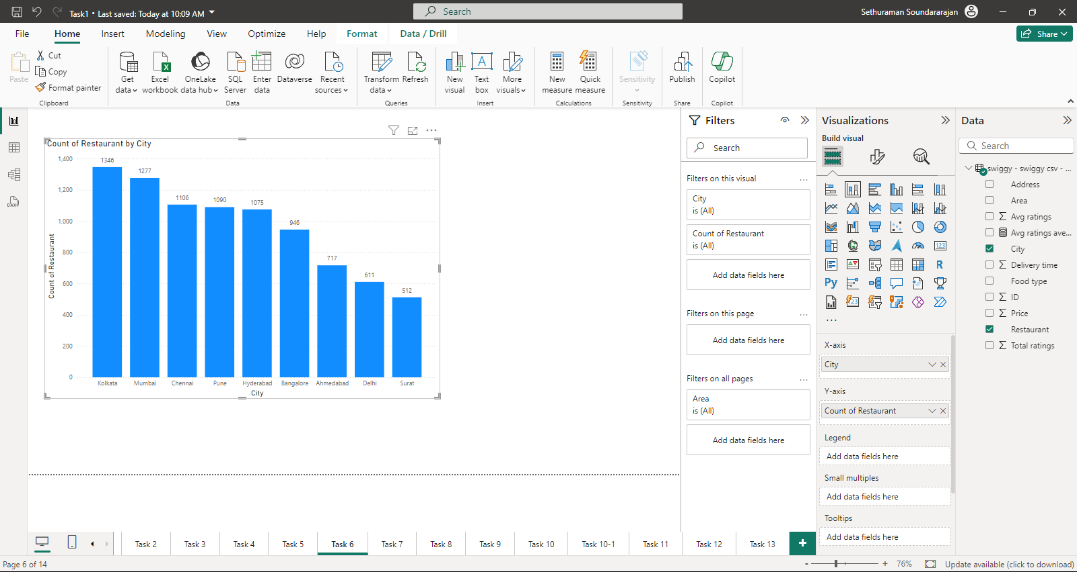
City-wise Restaurant Count
City | Count of Restaurant
Kolkata | 1346
Mumbai | 1277
Chennai | 1106
Pune | 1090
Hyderabad | 1075
Bangalore | 946
Ahmedabad | 717
Delhi | 611
Surat | 512

Slide 11
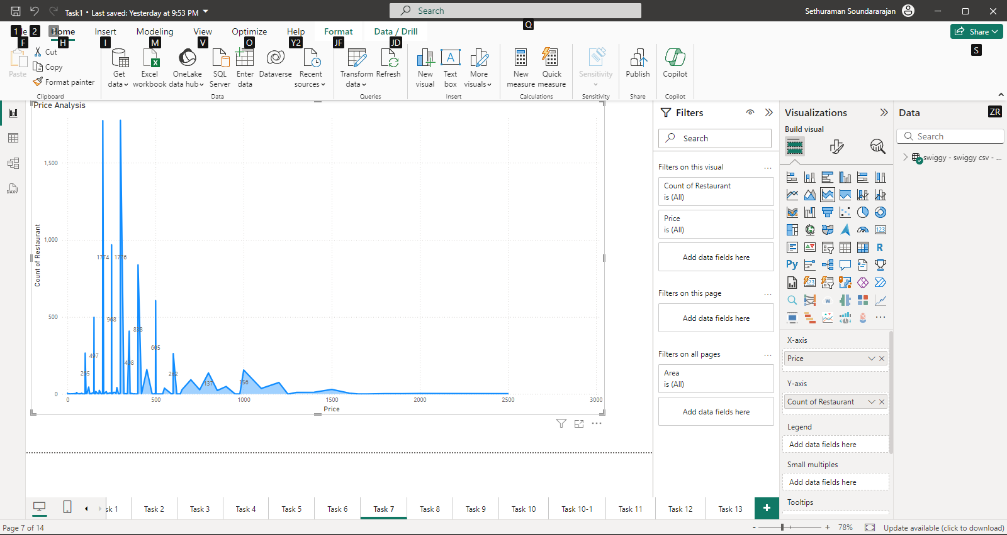
Price Analysis
Price | Count of Restaurant
300 | 1776
200 | 1774
250 | 968
400 | 838
500 | 605
150 | 497
350 | 408
100 | 265
600 | 262
450 | 158
1000 | 156
The price range between 100 to 1000 is the most common price set by the most restaurants

Slide 12
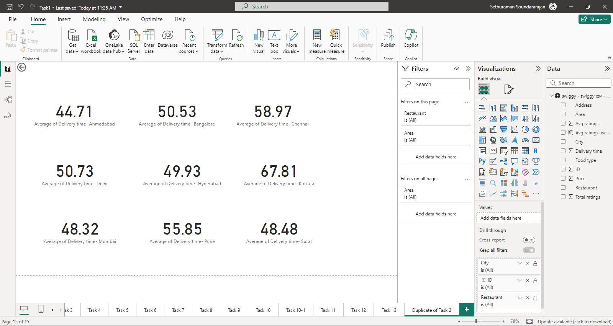
Delivery Time Analysis

Slide 13
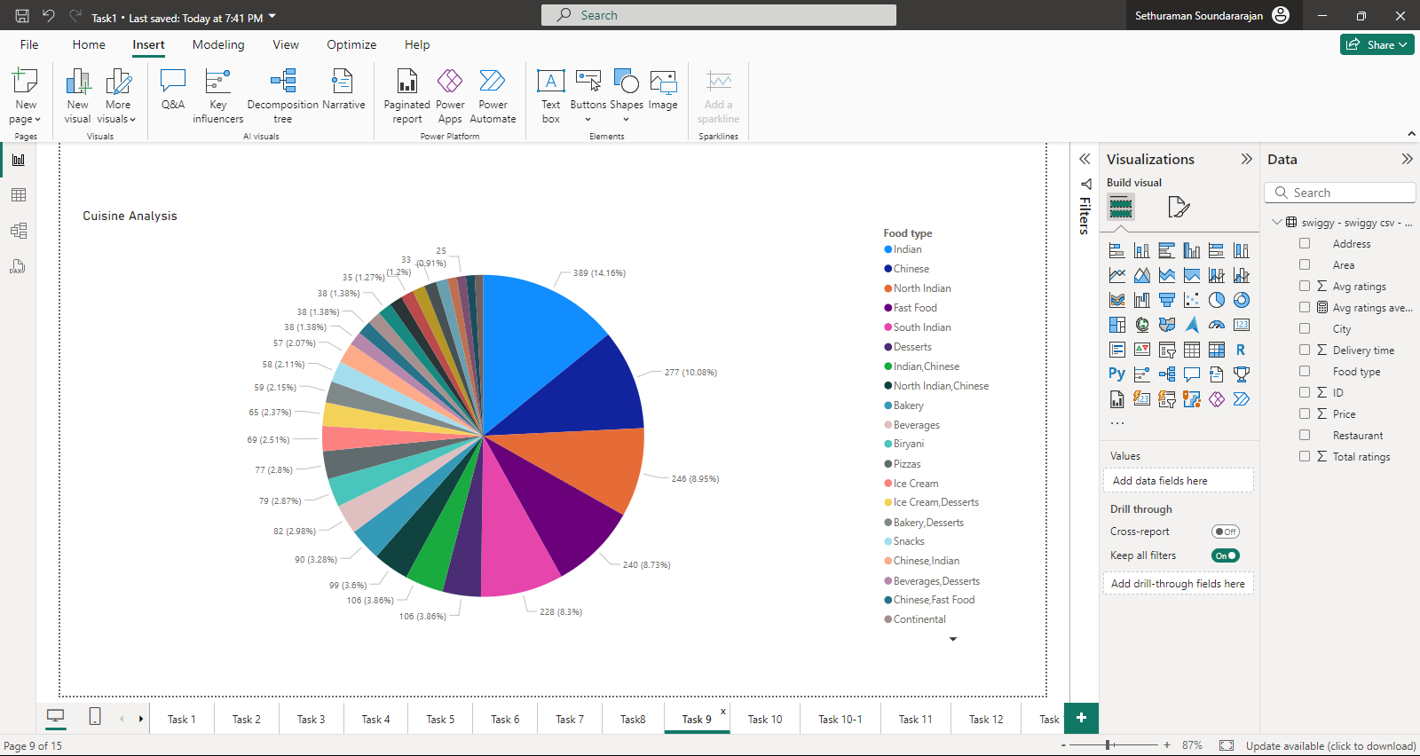
Cuisine Analysis
Count of Restaurant | Food type
389 | Indian
277 | Chinese
246 | North Indian
240 | Fast Food
228 | South Indian
106 | Desserts
106 | Indian,Chinese
99 | North Indian,Chinese
90 | Bakery
82 | Beverages
79 | Biryani
77 | Pizzas
69 | Ice Cream
Stacked column chart is used to analyze cuisines and the filter type TOP N =30 is used to filter the top cuisines

Slide 14
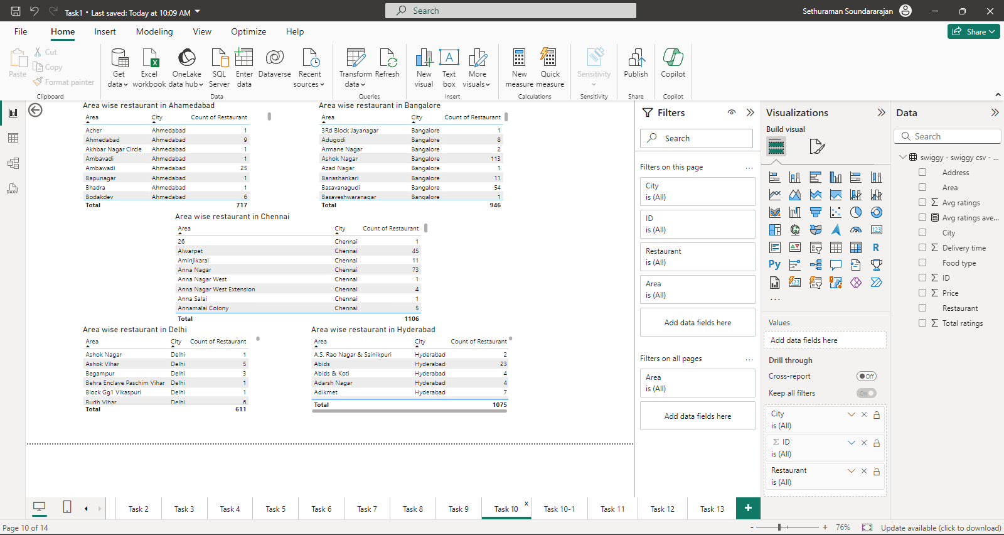
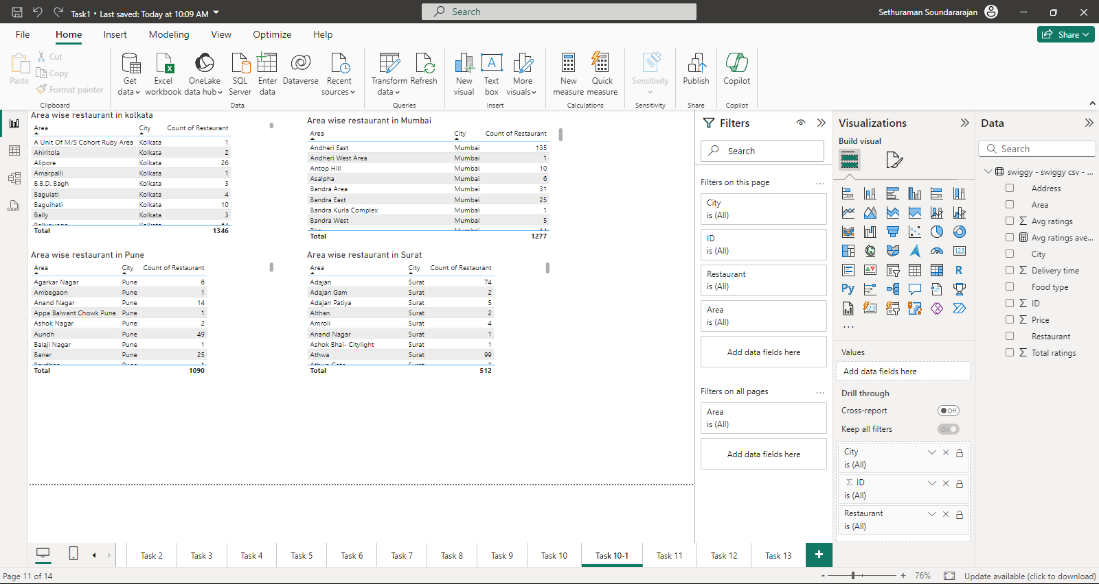
Area-wise Restaurant Analysis
The visualization type table is used to find the count of restaurant area wise in each city

Slide 15
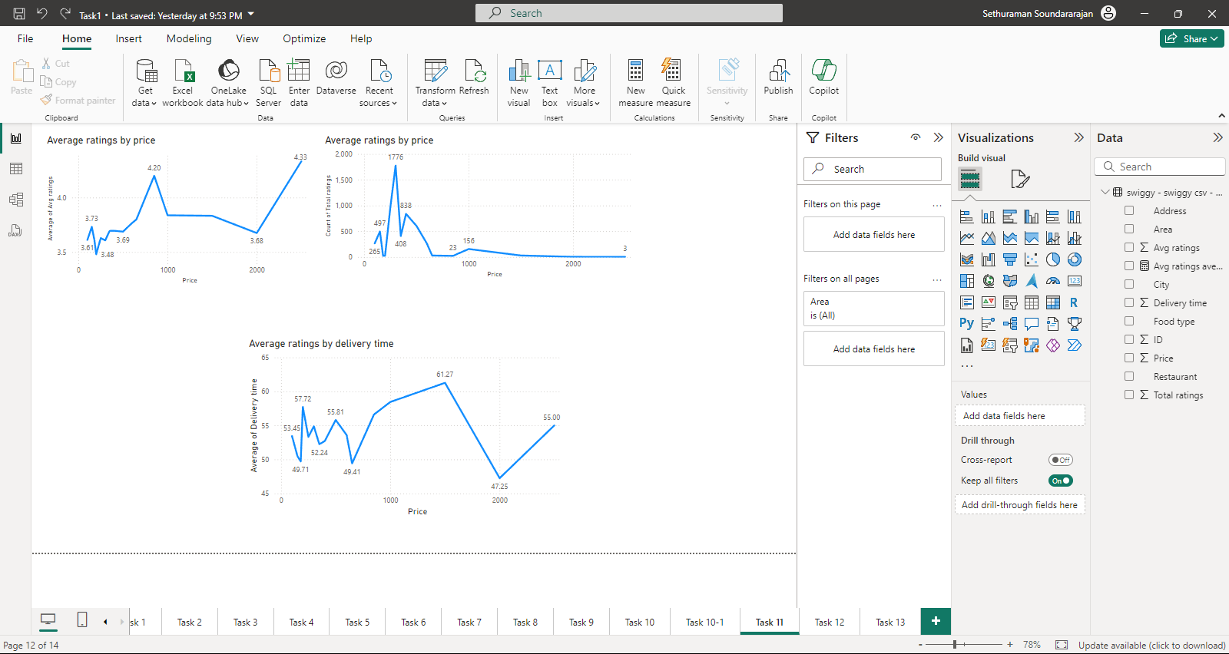
Correlation Analysis between Price,Ratings and delivery time
Price | Average Ratings
850 | 4.20
1000 | 3.84
1500 | 3.83
650 | 3.80
600 | 3.77
150 | 3.73
400 | 3.70
350 | 3.70
500 | 3.69
2000 | 3.68
250 | 3.63
100 | 3.61
300 | 3.61
180 | 3.60
200 | 3.57
199 | 3.48
Price | Count of Total ratings
300 | 1776
250 | 968
400 | 838
500 | 605
150 | 497
350 | 408
100 | 265
600 | 262
1000 | 156
1500 | 30
650 | 29
199 | 25
180 | 24
850 | 23
2000 | 4
2500 | 3
Price | Average of Delivery time
650 | 49
180 | 50
150 | 50
350 | 52
400 | 53
250 | 53
100 | 53
600 | 54
300 | 55
2500 | 55
500 | 56
850 | 57
199 | 58
1000 | 58
1500 | 61

Slide 16
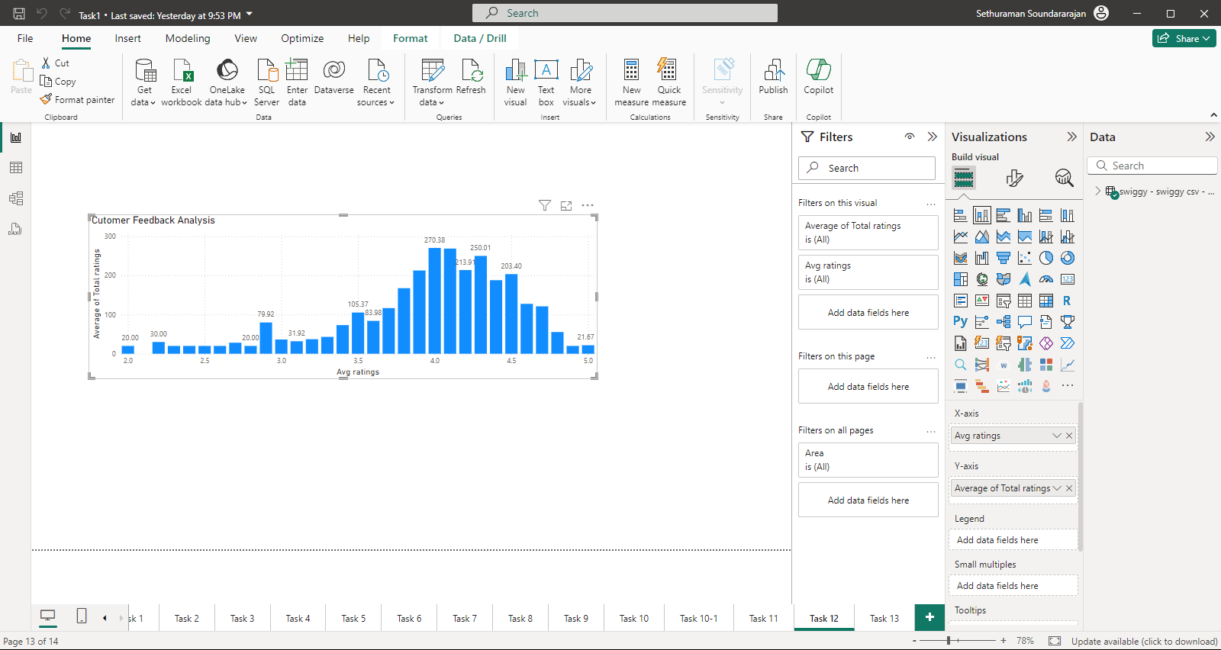
Customer Feedback Analysis
Avg ratings | Total ratings
4 | 270
4.1 | 269
4.2 | 214
4.3 | 250
4.4 | 188
4.5 | 203
It is clearly evident that average ratings ranging from 4 to 4.5 are rated by the highest number of people. Stacked area chart is used to plot the values.

Slide 17
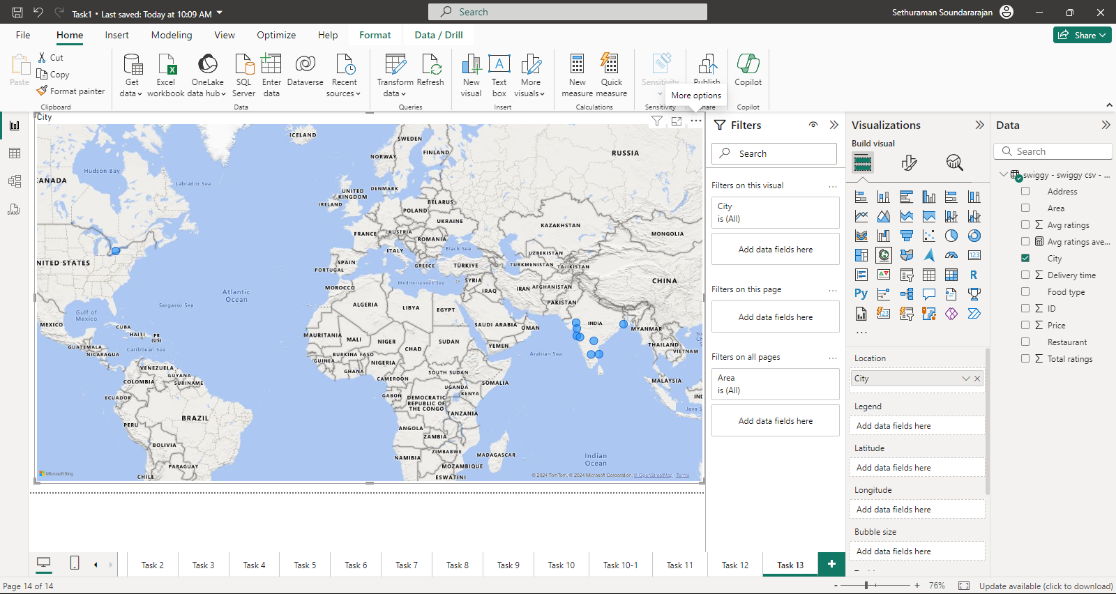
Geographical Mapping
City
Ahmedabad
Bangalore
Chennai
Delhi
Hyderabad
Kolkata
Mumbai
Pune
Surat

Slide 18
Business Recommendations
Indian food followed by Chinese cuisine tops the food types across the cities. Either the same food type can be updated with new recipes or focus on the next category of south Indian and north Indian type to improve and bring it to next level.
When the delivery time is between 24-29 minutes the rating is high which is about 4% out of 5%. More the delivery time , less the rating.
The count of ratings will be higher for the low rated food as well as the highly rated food.
The price of the food type within 150 -850 rupees gets the high rating, optimum delivery time and the total ratings.
Kolkata tops the restaurant count where as Surat has the least count of restaurant in the input given.
From the chart it is clearly evident that average ratings ranging from 4 to 4.5 are rated by the highest number of people.
Overall- delivery time , price and the cuisine type plays a major role for the high ratings.

Slide 19
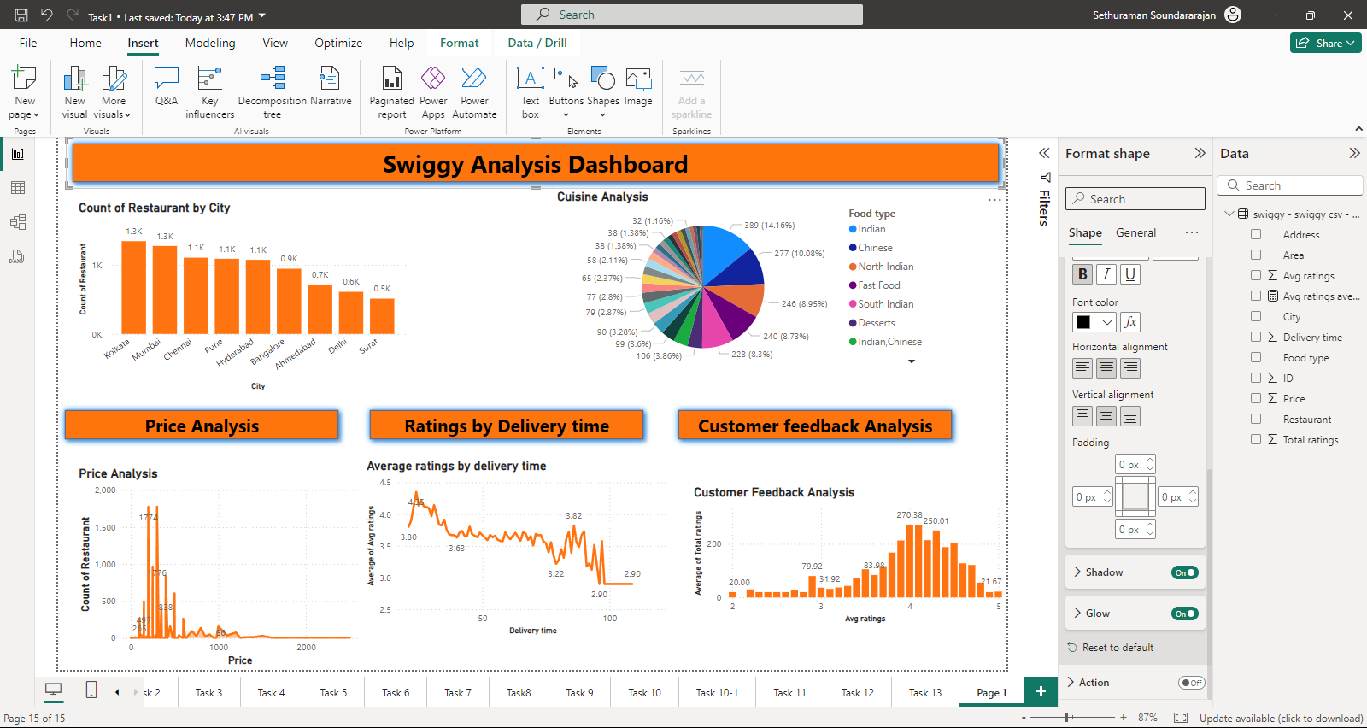
Swiggy Analysis - Dashboard

Slide 20
Conclusion and Summary
Improving (Maintaining) the delivery time and keeping the price range of the food type between 200-1000 will help to attract new customers.
Irrespective of regional insights Indian and Chinese food tops the customer rating, more dishes can be introduced in the same cuisine/food type.
The average rating seems to be good for the price range of dishes lesser than 1000.Since those food type comes under the top rated cuisine and delivery time is less than 40 mins. To improve the business average rating price and delivery time both should be considerably improved.

Slide 21
Thank you !

